Slide 1


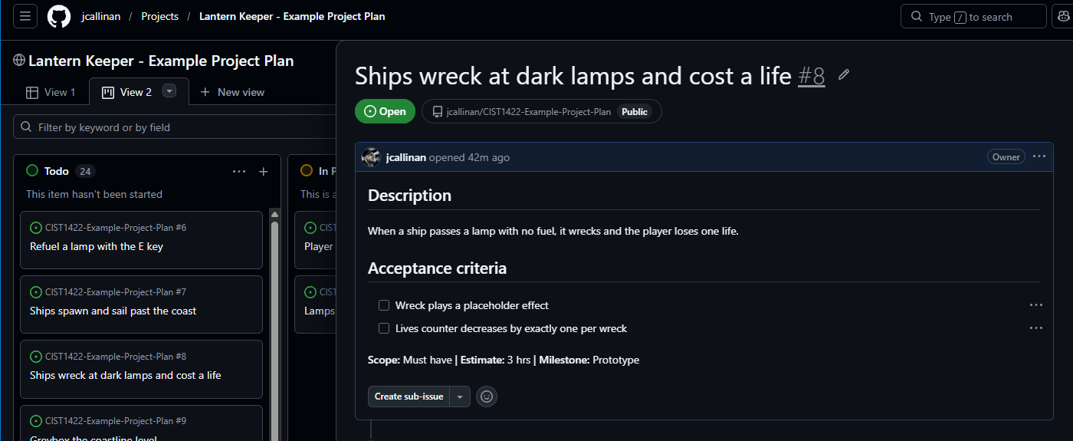
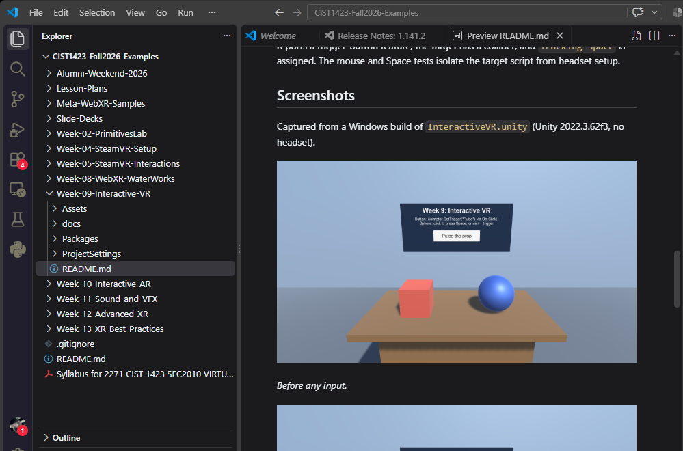
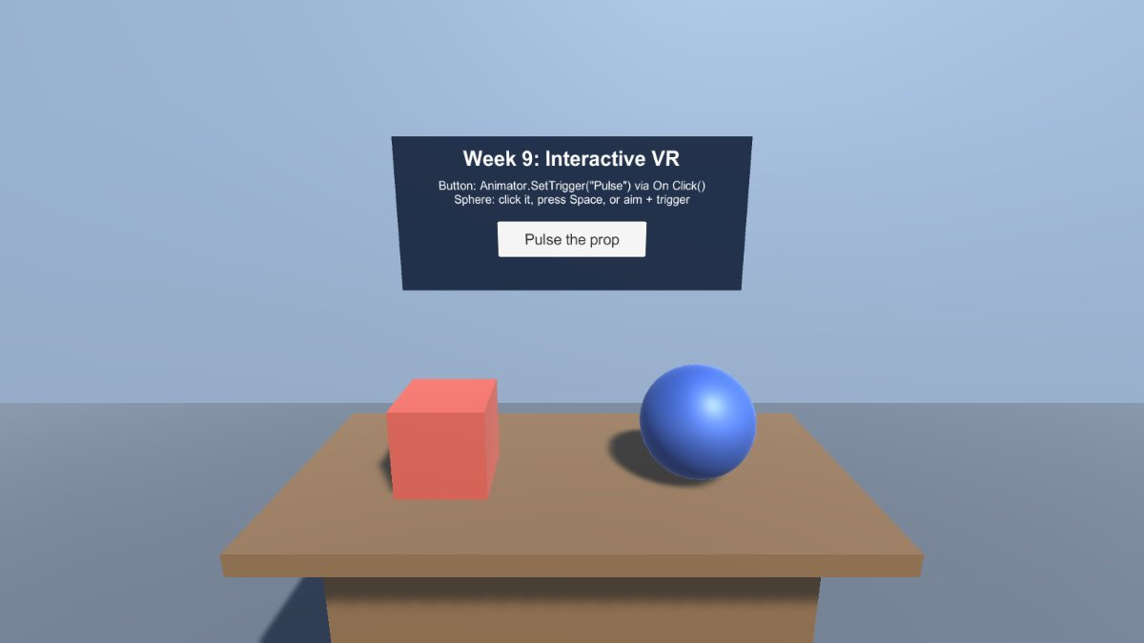
Virtual Reality
Week 10 - Chapter Examples,
Working on Projects
Wednesdays at 6:00pm
CIST 1423 - 2010 VIRTUAL REALITY PROGRAMMING AND TECHNOLOGY
Notes:
Syllabus Week 6. Next week (normally AR II) is WebXR building instead, so this week carries the core AR concepts.

Slide 2
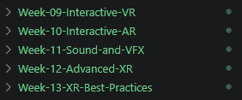
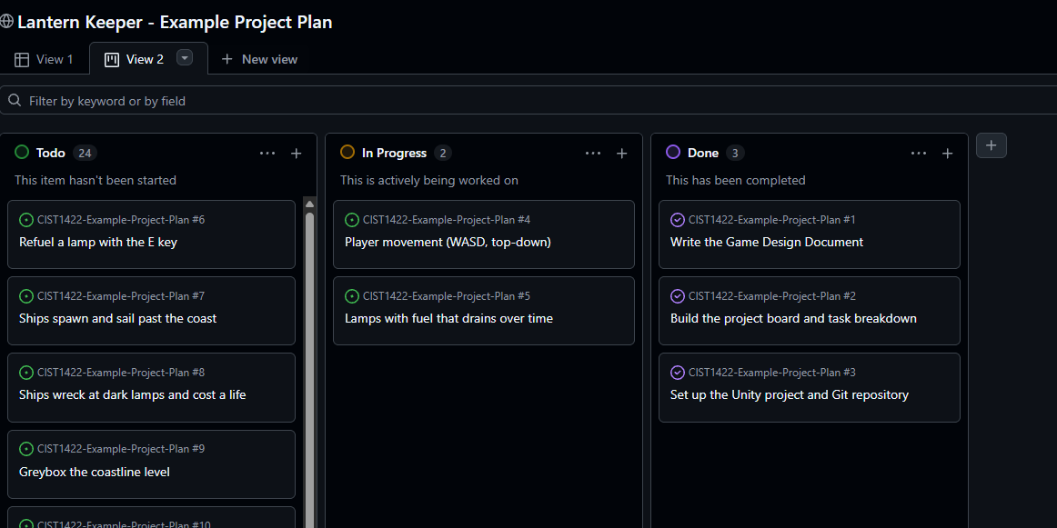
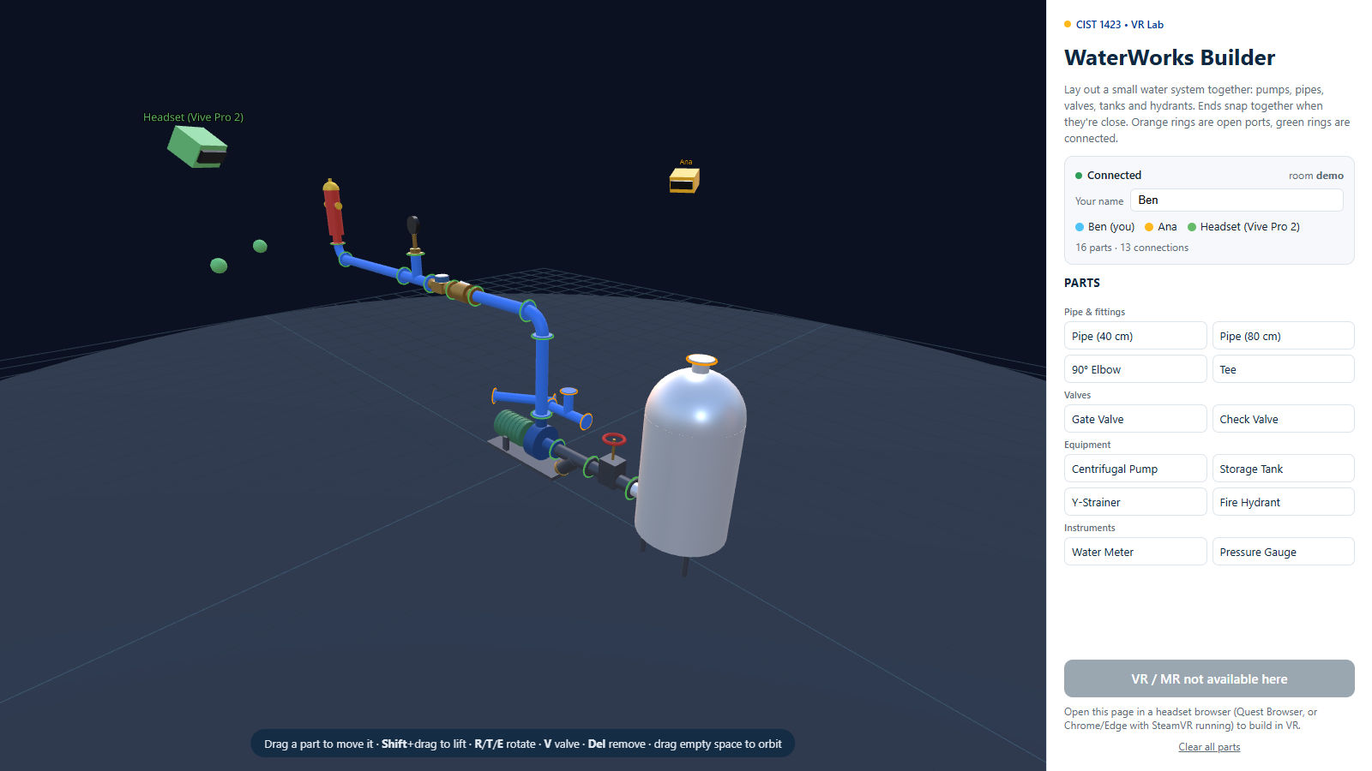
Agenda
Review example projects for chapters 5 and 6
  Chapter 5: Interactive VR: Animator triggers first, then C#
  Chapter 6: Interactive AR: the AR food menu app
Lab Setup
Work on your project ideas

Slide 3

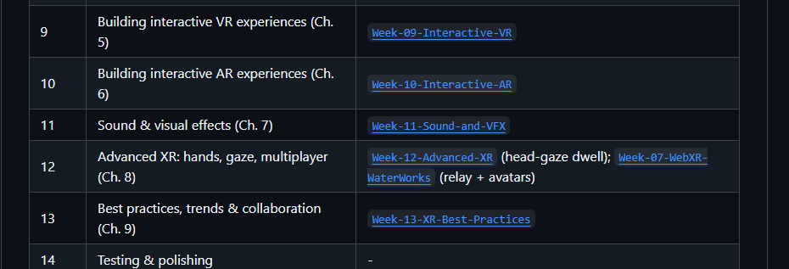
Chapters 5-9 Examples
https://github.com/jcallinan/CIST1423-Fall2026-Examples
Each example has a README.md that explains how to use it.

Slide 4
Five chapters, five projects, one skill each
THE MAP FOR TONIGHT
Ch. | What the book builds | The skill it teaches | Example folder
5 | VR car exhibition | Button events, Animator triggers, C# lifecycle | Week-09-Interactive-VR
6 | AR food menu | Plane raycasts, tap to place, pinch to scale | Week-10-Interactive-AR
7 | VR drum kit with fog | AudioSource, triggers, velocity, particles | Week-11-Sound-and-VFX
8 | Hands, gaze cubes, shared room | XR Hands, gaze interactor, Photon PUN 2 | Week-12-Advanced-XR
9 | No project: a field guide | Budgets, profiling, planning, UX, toolkits | Week-13-XR-Best-Practices
Every project starts the same way: XR Interaction Setup prefab at (0,0,0), Main Camera deleted, OpenXR enabled with your headset’s interaction profile.
CIST 1423 · Week 10 · Overview
Notes:
The book recommends XR Interaction Toolkit 2.5.1. Newer toolkit versions rename some prefabs and sample paths, so if a path in the book doesn't match your project, search the Project window for the prefab name instead of following the folder path. Our example folders were numbered by course week, which is why Chapter 5 lives in Week-09.

Slide 5
Building Interactive VR Experiences
05
A virtual car exhibition: a spinning taxi, a growing police car and a bus you scale with a slider. No code first, then C#.
Book pages 99–124 · Example: Week-09-Interactive-VR
Notes:
Chapter 5 has two halves. The first half builds every interaction with the Animator and UnityEvents, no code. The second half explains when code becomes necessary and writes a small C# script.

Slide 6
Build the car exhibition scene
CHAPTER 5 · SET THE STAGE
1 New scene CarExhibition; delete Main Camera.
2 Ground: a Cube at the origin, scale (20, 0.1, 20).
Three ways to teleport
3 Import Simple Cars Pack. Taxi at (-6, 0, 0) scale 2; Police_car at (6, 0, 0).
Teleport Anchor
4 Magenta cars? Install URP, set materials to URP/Lit, or run Window › Rendering › Render Pipeline Converter.
A fixed spot. The ray glides over it.
Snapping Teleport Anchor
5 Drop in XR Interaction Setup at (0, 0, 0).
A fixed spot. The ray snaps to it. Used here.
6 Two Snapping Teleport Anchors at (±2, 0, 0), scale (2, 1, 2).
Teleportation Area
7 Taxi: a push button on a cylinder pedestal. Police car: an XR UI Canvas, World Space, scale 0.001, two TextButtons.
Land anywhere inside the zone.
Teleport-only movement is the simplest guard against motion sickness for new VR users.
CIST 1423 · Week 10 · Ch. 5 — Building Interactive VR Experiences (pp. 100–106)
Notes:
Magenta means the material's shader doesn't exist in your render pipeline. The VR template doesn't include URP by default, so install it first. The Render Pipeline Converter batches the fix, but still spot-check each material afterward. The canvas scale of 0.001 matters: a canvas is measured in pixels, and at scale 1 a 500-pixel canvas is 500 meters wide in VR.

Slide 7
Interactable events you can hook without code
CHAPTER 5 · THE PUPPET STRINGS
Hover
Select
Activate
You point at it
You press or grab it
You use it while holding
First Hover Entered
first pointer arrives
Hover Entered
every time
Hover Exited
pointer leaves
Last Hover Exited
no one is pointing
First Select Entered
first press
Select Entered
every press
Select Exited
release
Last Select Exited
last hand lets go
Activated
trigger pulled on a held object: start the engine
Deactivated
trigger released: engine winds down
Find them on XR Simple Interactable (and the push button) under Interactable Events. Click +, drag a target in, pick a function.
CIST 1423 · Week 10 · Ch. 5 — Building Interactive VR Experiences (pp. 106–107)
Notes:
The “First” and “Last” versions matter when more than one interactor can touch the same object: two hands, or a hand plus a gaze ray. First Hover Entered fires once when the first interactor arrives; Last Hover Exited fires once when the final one leaves. We use exactly that pair again in Chapter 8 for the gaze cubes.

Slide 8
Clips hold the motion; the Animator decides when
CHAPTER 5 · NO CODE: THE SPINNING TAXI
Animation clip
Animator Controller
Keyframes over time. RotateCar: Rotation.y 0 at 0:00 → 355 at 0:10, Loop Time on. 355, not 360, so the loop doesn’t stutter.
A state machine of clips. Transitions fire on parameters: here two Triggers, Rotate and StopRotation.
trigger: Rotate
Push button events:
Select Entered → Animator.SetTrigger("Rotate")
Select Exited → Animator.SetTrigger("StopRotation")
Idle (default)
RotateCar
trigger: StopRotation
Set Idle as Layer Default State, or the taxi spins the moment the scene loads.
CIST 1423 · Week 10 · Ch. 5 — Building Interactive VR Experiences (pp. 107–111)
Notes:
Walk the steps: create an Animations folder; select the taxi; Window › Animation › Animation; Create clip RotateCar; keyframe rotation; tick Loop Time on the clip. Adding the clip creates an Animator Controller. Open it, create an empty state called Idle, set it as default, make transitions both ways, add the two trigger parameters, and set each transition's condition. Finally, on the push button, add the taxi to Select Entered and Select Exited and choose Animator.SetTrigger with the trigger name typed in. Hold the button and the taxi spins; let go and it stops.

Slide 9


Two UI buttons drive a three-state Animator
CHAPTER 5 · NO CODE: THE POLICE CAR
ScaleCar
Scale 0 at 0:00 → 3 at 1:00
ScaleCar
ScaleBig
ShrinkCar
Scale 3 at 0:00 → 0 at 1:00
Idle
ScaleBig
ScaleSmall
Uncheck Loop Time on both: each plays once, then holds.
Canvas: Vertical Layout Group, spacing 5, Middle Center, Child Force Expand, so the two buttons stack themselves.
ScaleSmall
ShrinkCar
Each button’s On Click () → police car → Animator.SetTrigger("ScaleBig") or ("ScaleSmall").
CIST 1423 · Week 10 · Ch. 5 — Building Interactive VR Experiences (pp. 112–114)
Notes:
Why the cross transitions between ScaleCar and ShrinkCar? Without them the car can only grow or shrink once from Idle, then it is stuck. With them, the user can bounce back and forth as often as they like. This is the same pattern you'd use for a door: Open and Closed states with triggers both ways.

Slide 10
Reach for C# when the motion depends on the moment
CHAPTER 5 · ANIMATOR OR C#?
Step | Animator only | With C#
Start event | The events you’re given: button press, UI click | Anything: combos, collisions, zones, health, network messages, AI decisions
Animation | Keyframes made ahead of time | Play/pause/speed keyframed clips, or set Transform values directly
State control | Parameters inside the controller | Any game state: score, inventory, player position
Real-time input
Physics
Procedural
AI behavior
Flight stick moves the ailerons
Pool balls follow forces, not paths
Dungeon generated at runtime
Enemy picks idle, walk or attack
CIST 1423 · Week 10 · Ch. 5 — Building Interactive VR Experiences (pp. 114–116)
Notes:
They are not either/or. Most real projects use both: the Animator holds hand-made clips like a walk cycle, and C# decides which one plays and when. The bus slider coming up is the “real-time input” case: the scale depends on where the user drags the slider at that instant, so no keyframe can know it in advance.

Slide 11
Unity calls your methods; you fill them in
CHAPTER 5 · C# IN UNITY
Awake()
OnEnable()
Start()
FixedUpdate()
Update()
LateUpdate()
Script loads. Set references.
Object becomes active. Subscribe.
Before first frame, if enabled.
Fixed rate. Physics.
Every frame. Input, movement.
After all Updates. Cameras.
XR Interaction Toolkit adds
public class XRGrab : MonoBehaviour {
public XRGrabInteractable grab;
bool isGrabbed;
void OnEnable() {
grab.selectEntered.AddListener(
_ => isGrabbed = true);
grab.selectExited.AddListener(
_ => isGrabbed = false);
}
}
Hover Entered / Exited: pointing at it
Select Entered / Exited: grabbing or pressing
Activate / Deactivate: trigger while holding
Variables hold data. Functions are recipes. Classes are blueprints; every script is a class that inherits MonoBehaviour. Class names are PascalCase.
CIST 1423 · Week 10 · Ch. 5 — Building Interactive VR Experiences (pp. 116–120)
Notes:
The book's XRGrab example subscribes with onSelectEntered and onSelectExited. Those older event names are deprecated in the XR Interaction Toolkit; the current names are selectEntered and selectExited, which is what's on the slide (written with lambdas to fit). The idea is identical: subscribe in OnEnable, and good practice is to unsubscribe in OnDisable. Naming rules for classes: start with a capital letter, no spaces, special characters or underscores, and no reserved words like class, int or void.

Slide 12
BusScaler binds a slider’s value to the bus’s scale
CHAPTER 5 · WITH C#: THE BUS SLIDER
using UnityEngine;
using UnityEngine.UI;
public class BusScaler : MonoBehaviour
{
public GameObject bus;
public Slider slider; // Min 0, Max 5
private void Awake() {
bus.transform.localScale = Vector3.one;
}
private void Update() {
float s = slider.value;
bus.transform.localScale = new Vector3(s, s, s);
}
}
Wire it up
1 Bus_2 at (0, 0, -6), rotated -90° on Y.
2 Bus Scale Canvas: XR UI Canvas, World Space, scale 0.01, at (0, 1.5, -5), rotated 180°.
3 Add UI › Slider (0 to 5) and a TMP label.
4 Empty Bus Scaler Controller + script; drag bus and slider into the fields.
5 Third teleport anchor at (0, 0, -2.5).
Try next: replace Update() with slider.onValueChanged so the script only runs when the value changes.
CIST 1423 · Week 10 · Ch. 5 — Building Interactive VR Experiences (pp. 120–124)
Notes:
Public fields show up in the Inspector, which is how the script gets its references without a Find call. The book polls the slider every frame in Update; that's fine for one slider but wasteful at scale. The onValueChanged event version is a nice extension for students who finish early. Test the whole CarExhibition scene with the simulator or on the Vive: teleport to the taxi, the police car and the bus.

Slide 13
Building Interactive AR Experiences
06
An AR restaurant menu: find the table, place a dish at real size, pinch to scale, swipe through the menu with its nutrition facts.
Book pages 125–151 · Example: Week-10-Interactive-AR
Notes:
Chapter 6 builds on the AR Foundation setup from Chapter 4. Everything here runs on an ARCore Android phone or an ARKit iPhone; you can also test parts in the Editor with the XR Simulation environment from Chapter 4.

Slide 14
Successful AR apps share one simple pattern
CHAPTER 6 · DESIGN PATTERNS
Gaming
Navigation
Shopping
Education
Pokémon Go. Creatures in your world; GPS + touch.
Google Maps Live View. Arrows over the street; GPS + orientation.
IKEA Place. Furniture on your floor at true scale.
Star Walk 2. Image targets anchor 3D models.
Camera feed + device pose (+ GPS) → place a 3D model in the real world → touch or walk around to inspect it.
ADDS NOTHING
ADDS VALUE
A flat menu floating over the table. Paper does that.
Each dish at real serving size on your table. You see what you’ll get.
CIST 1423 · Week 10 · Ch. 6 — Building Interactive AR Experiences (pp. 126–127)
Notes:
The book's key design advice: don't force AR into an app. Ask what the real world adds. For your projects, if you're doing AR, be able to say in one sentence why the camera view makes the experience better than a 2D screen would.

Slide 15
The ARFoodMenu scene, from hierarchy to scripts
CHAPTER 6 · THE PIECES
ARFoodMenu
├ AR Session
├ AR Session Origin + ARPlacePrefab
│ AR Plane Mgr (Horizontal), AR Raycast Mgr
│ └ AR Camera
│ └ Canvas follows the camera
│ ├ ButtonNext ( -> )
│ ├ ButtonPrevious ( <- )
│ └ InfoPanel
│ ├ InstructionText
│ └ PlaceFirstMealButton
├ FoodInfoCanvas › FoodInfoText
└ PrefabManager + SwapPrefab
AR Session + Session Origin
The stage: tracking lifecycle, and the bridge from device space to Unity space.
Plane Manager
Finds real surfaces. Horizontal only: we want tables.
Raycast Manager
Shoots rays at those planes to find where a dish can sit.
Three scripts
Food holds data, ARPlacePrefab places and scales, SwapPrefab cycles the menu.
CIST 1423 · Week 10 · Ch. 6 — Building Interactive AR Experiences (pp. 128–129)
Notes:
Setup: new scene ARFoodMenu, delete Main Camera, add XR › AR Session Origin and XR › AR Session. On the Session Origin, add AR Plane Manager, set its Plane Prefab to ARPlane and Detection Mode to Horizontal, then add AR Raycast Manager with no prefab, since we only need the hit math. The main script lives on the Session Origin because that's where real-world alignment lives.

Slide 16
Get the food models, then build two kinds of UI
CHAPTER 6 · CONTENT AND UI
Food models
Locked to the screen
Anchored in the world
Model it: Blender, Maya, 3ds Max
Scan it: photogrammetry (Luma, RealityCapture, Meshroom, Metashape)
Download it: Asset Store, Sketchfab, TurboSquid; check the license
Hire it: a 3D artist
Canvas as a child of AR Camera, World Space, scale 0.01, at (0, 0, 1). Always in view.
FoodInfoCanvas › FoodInfoText is not a camera child. Code moves it above each placed dish and fills in name, ingredients, calories, diet.
Arrow buttons, plus InfoPanel: “Wait until the blue surface is visible” and Place First Meal.
Placement grid: a blue GridMaterial in Assets/Resources, loaded by name with Resources.Load.
One SetActive(false) on InfoPanel hides all three.
Book uses free packs: French Fries, Tofu, Kashipan.
CIST 1423 · Week 10 · Ch. 6 — Building Interactive AR Experiences (pp. 129–133, 140)
Notes:
Point out the photogrammetry option: it's the same workflow we used for the Panther statue scan. For food it's harder, because uniform colors and textures give the software little to match. The Resources folder is special in Unity: anything inside it can be loaded by name at runtime, which is why the material must be named exactly GridMaterial and live in a folder called Resources. We'll use Resources again in Chapter 8 for Photon.

Slide 17
Every frame: look at screen center, find a table, wait for a tap
CHAPTER 6 · ARPLACEPREFAB
1 · Two fingers?
2 · Find pose
3 · Show grid
4 · Tap began?
PinchToScale()
Ray from (0.5, 0.5) of the view onto planes
Indicator at the hit; hidden if none
PlaceObject(): replace dish, scale 0.5, buttons at ±0.5 m
private void UpdatePlacementPose() {
var screenCenter = Camera.current.ViewportToScreenPoint(new Vector3(0.5f, 0.5f));
var hits = new List<ARRaycastHit>();
_arRaycastManager.Raycast(screenCenter, hits, TrackableType.Planes);
_placementPoseIsValid = hits.Count > 0;
if (_placementPoseIsValid) {
_placementPose = hits[0].pose; // closest hit wins
PositionGrid(hits[0].pose.position, hits[0].pose.rotation);
} else _placementGrid.SetActive(false);
}
CIST 1423 · Week 10 · Ch. 6 — Building Interactive AR Experiences (pp. 135–143)
Notes:
This is the heart of most mobile AR apps, so it's worth slowing down. The ray always starts at the center of the screen, so the user aims by moving the phone, not by tapping a spot. Raycast fills a list of hits sorted by distance; hits[0] is the nearest plane. The pose gives both position and rotation, so the dish sits flat on the table. PlaceObject destroys the previous dish before instantiating the new one, so there's only ever one dish on the table. The Place First Meal button calls PlaceObjectIfNeeded, which also hides the InfoPanel.

Slide 18
A data class, a wrapping index, and pinch to scale
CHAPTER 6 · FOOD AND SWAPPREFAB
[System.Serializable] // editable in Inspector
public class Food {
public string name, ingredients, calories, dietType;
public GameObject prefab;
}
// SwapPrefab.cs
public Food[] AvailableFoods;
public void SwapFoodPrefab() {
CurrentFoodIndex = (CurrentFoodIndex + 1)
% AvailableFoods.Length; // wraps to 0
ARPrefabPlacement.ObjectToPlace =
AvailableFoods[CurrentFoodIndex].prefab;
ARPrefabPlacement.PlaceObject();
// ...then fill InfoText with rich text
}
Pinch to scale
Change in finger distance × 0.001, added to the scale, clamped between 0.1 and 10.
Wire it up
Empty PrefabManager + SwapPrefab. ButtonNext → SwapFoodPrefab(); ButtonPrevious → SwapToPreviousFoodPrefab(). Fill three dishes in the Inspector. Uncomment the SwapPrefab lines in ARPlacePrefab.
Previous wraps the other way: below 0 → Length − 1.
CIST 1423 · Week 10 · Ch. 6 — Building Interactive AR Experiences (pp. 133–148)
Notes:
Serializable is what lets an array of plain C# objects show up as editable rows in the Inspector, which is how we type in French Fries, Tofu and Kashipan with their nutrition info without a database. The modulo trick is worth teaching on its own: with three foods, index 2 plus 1 is 3, and 3 mod 3 is 0, so the menu loops. The info text uses TextMeshPro rich-text tags like b and color for formatting.

Slide 19
If the book’s AR code fights your project, check these first
CHAPTER 6 · BOOK VS. YOUR UNITY VERSION
The book (2023) | What you may see now | Do this
AR Session Origin | Deprecated in AR Foundation 5+ | Use XR Origin (AR); same managers
FindObjectOfType<T>() | Obsolete warning in Unity 6 | FindFirstObjectByType<T>(), or a public field
Input.touchCount, GetTouch | Errors if only the new Input System is on | Active Input Handling = Both, or EnhancedTouch
Camera.current in Update | Can be null outside rendering | Reference the AR Camera, or Camera.main
Commented-out lines | SwapPrefab doesn’t exist yet | Uncomment after creating SwapPrefab
Read the Console from the top. The first error is usually the real one; the rest are fallout.
CIST 1423 · Week 10 · Ch. 6 — Building Interactive AR Experiences
Notes:
These are not mistakes in the book so much as two years of package updates. Check the README in Week-10-Interactive-AR for the exact Unity and AR Foundation versions the example was built with. If the managers look different in your project, the concepts are unchanged: something tracks the session, something maps device space to Unity space, something finds planes, and something raycasts against them.

Slide 20
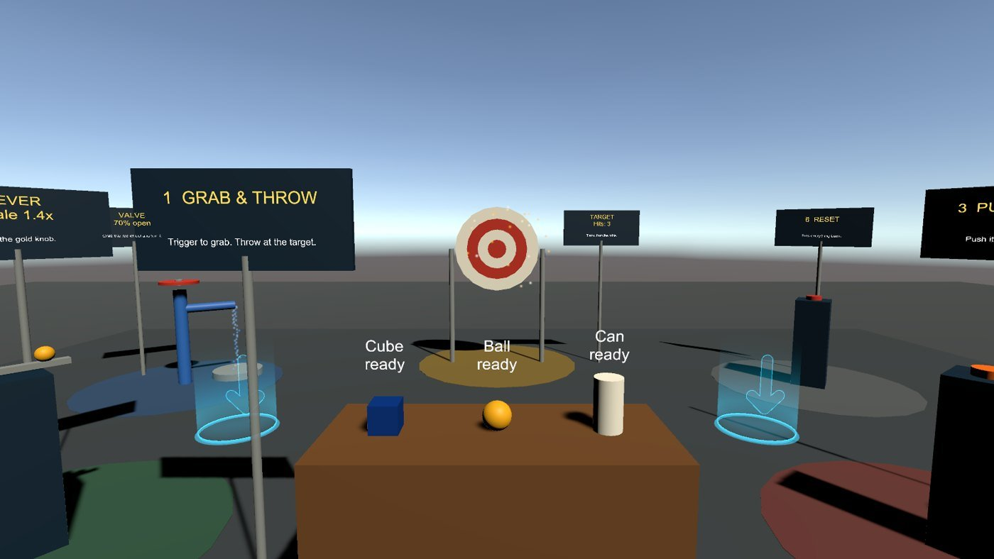
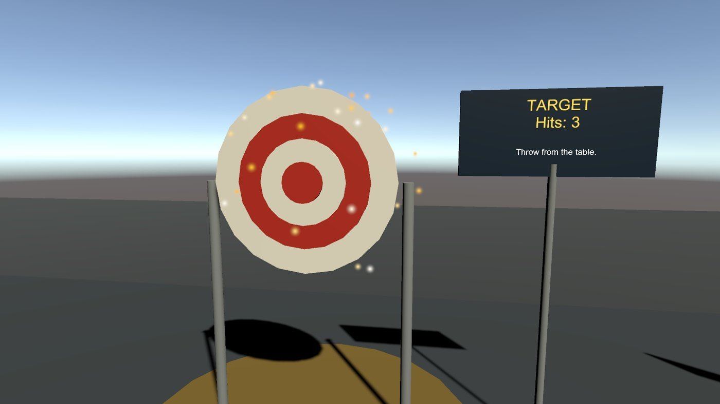
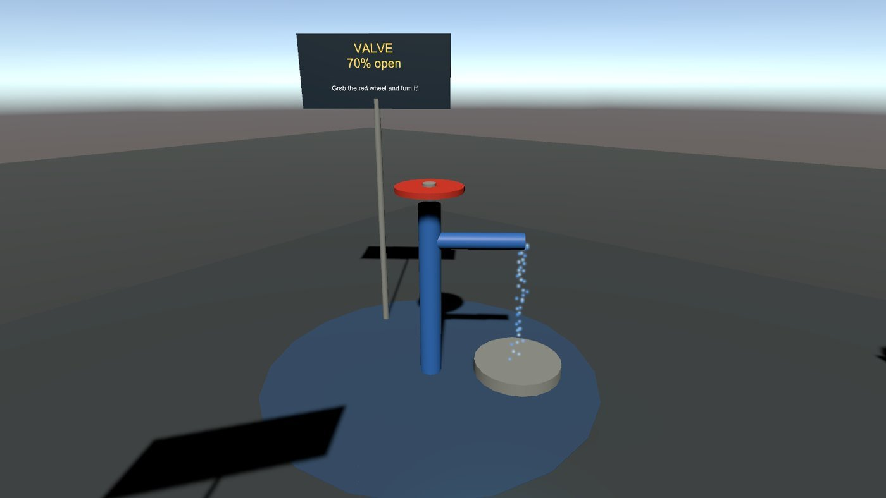
SteamVR Playground Testing and HTC Vive Setup
Test on the VR Stage
Let's also set up another HTC Vive

Slide 21
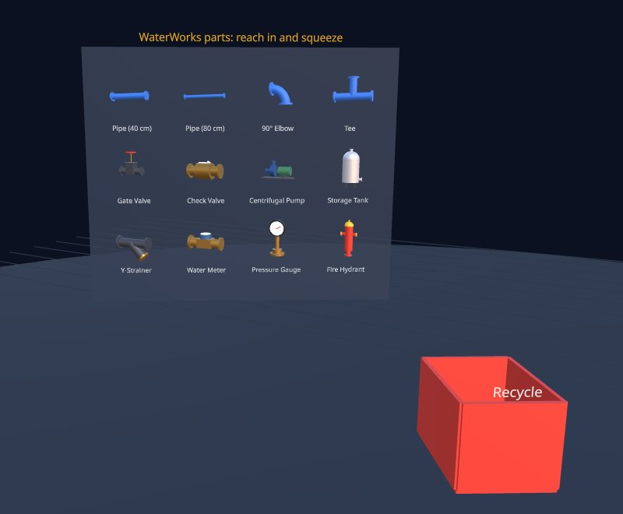
AR on the web: Beta Test WaterWorks Builder
WaterWorks Builder is a multiplayer WebXR sandbox for laying out a small water system: storage tank → gate valve → Y-strainer → centrifugal pump → riser → check valve → meter → tee with pressure gauge → main → hydrant. Everyone in the same room sees the same parts, sees each other's heads and hands, and only one person can hold a part at a time.
https://github.com/jcallinan/CIST1423-Fall2026-Examples/tree/master/Week-08-WebXR-WaterWorks
Quest 3
Hololens
Vive XR

Slide 22
Next steps: Planning the project
Work your project's tech definition and project plan, and complete by next week , I extended it a week - https://canvas.pitt.edu/courses/381238/assignments/2244240?module_item_id=7074251
Check out GitHub Project - https://github.com/users/jcallinan/projects/2/views/2
Review chapter examples - https://github.com/jcallinan/CIST1423-Fall2026-Examples
Exam soon
CIST 1423 — Week 6 — AR Development in Unity I (Ch. 4, first half)

